Slide 1


Taking Probabilistic Monitoring Data to the Next Level: Evaluating Stressor Risk in Aquatic Life Use Total Maximum Daily Loads
Jason Hill, Emma Jones, Mary Dail
Larry Willis, and Lucy Baker
Notes:
Heads up:
Fly through presentation so we can spend more time demoing the neat tool we’ve developed using ProbMon Data to help inform the stressor analysis process for benthic TMDLs
Thank Jason, Mary, Larry, Lucy for help with the analysis, reporting, and all their efforts pushing project through management because that was no small feat

Slide 2
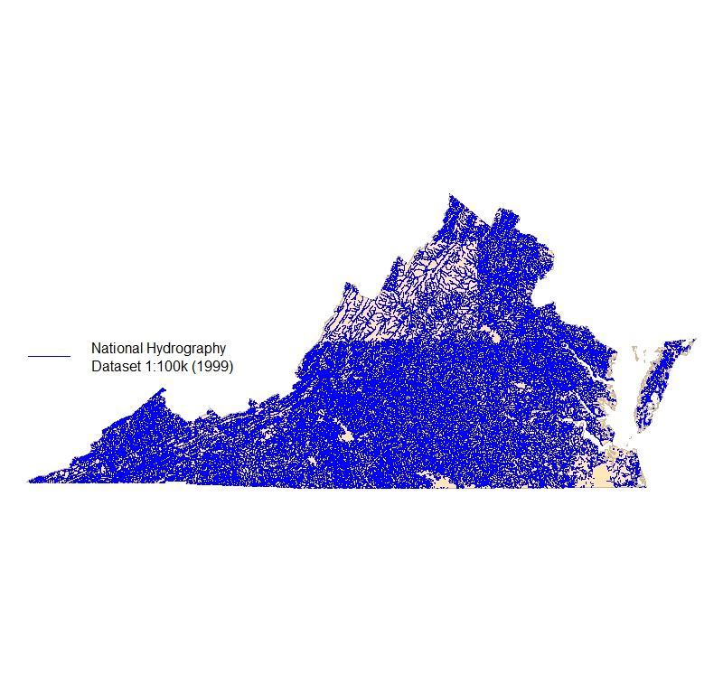
Freshwater Probabilistic Monitoring in Virginia
Provides estimates for all perennial, non-tidal stream and river miles which equates to approximately 49,100 miles across Virginia
~ 41,500 miles wadeable
~ 1,200 miles non-wadeable
~ 5,000 miles wetlands
Notes:
Quick background on our ProbMon program:
The Virginia sample frame encompasses ~49,000 stream miles across the Commonweath
Focus on DATA from wadeable sites, which are 1st through about 5th order streams, that allows us to make statistically valid estimates of water quality parameters for over 41,000 miles across the state.
Only using wadeable because we don’t have validated benthic indices for non wadeable methods

Slide 3
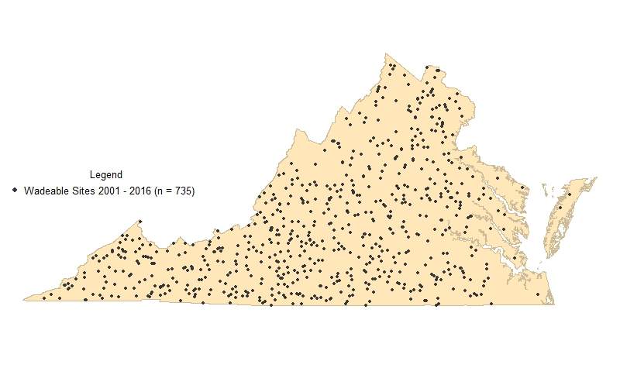
Freshwater Probabilistic Monitoring in Virginia
Monitoring statewide 2001 - present
~ 60 ProbMon Sites / Year
735 paired benthic and water chemistry/habitat data points
(2001 – 2016)
Notes:
Since 2001 we have collected about 60 sites year, such that, through 2016, we have 735 sites of paired benthic, water chemistry, and habitat data

Slide 4
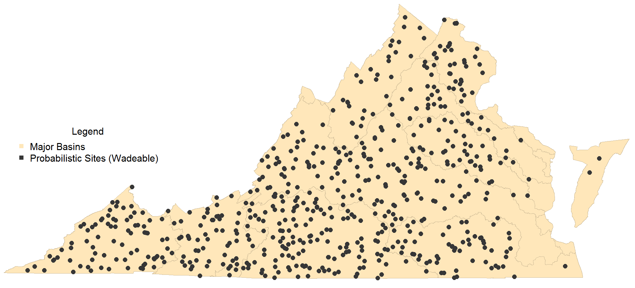
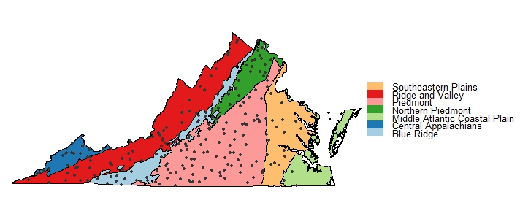
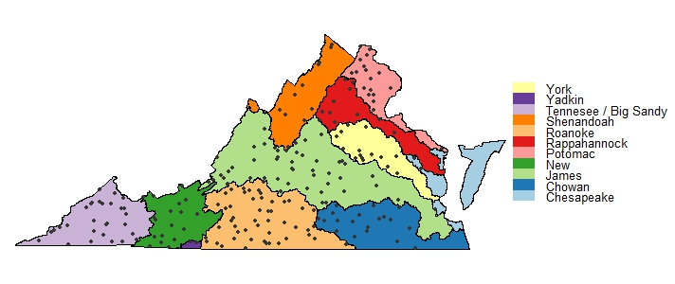
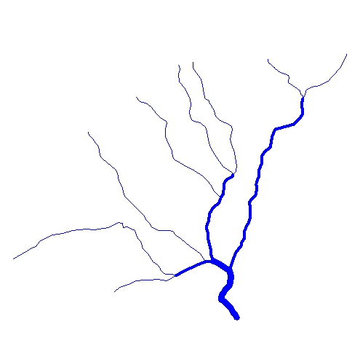
Analysis Scale
US EPA Level III
Ecoregion
Statewide
00
00
Stream Order
Major Basin
Notes:
The density of this dataset has allowed us to start breaking up out estimates at various spatial scales instead of just statewide estimates.
Allowing us to drill in by ecoregion, basin, and stream order .
We finally have the n to make statistically valid statements about these different spatial scales and can start to compare different parameters and biological response spatially

Slide 5
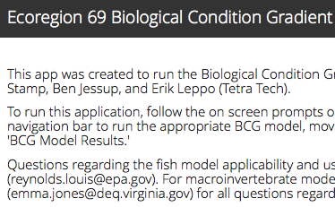
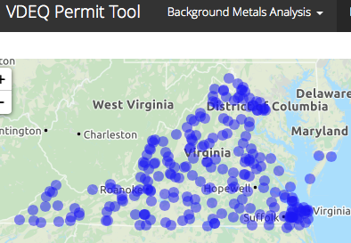
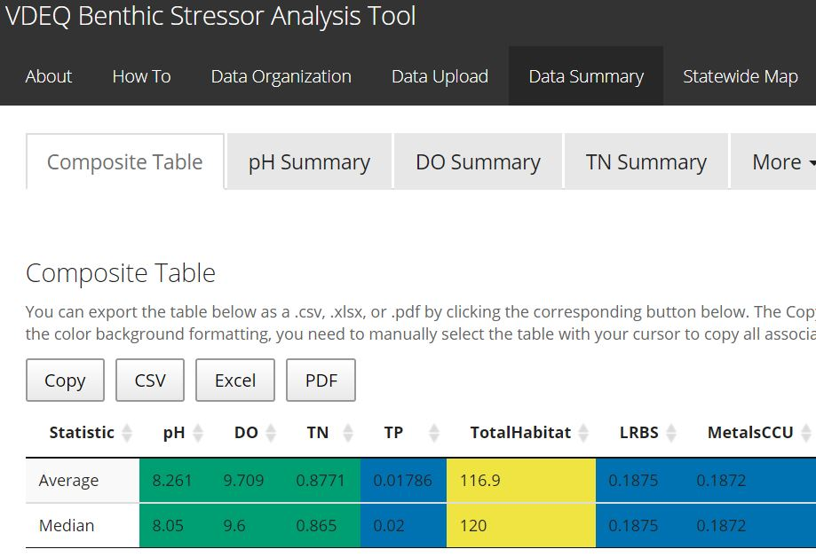
ProbMon Data Applications
Notes:
Since this is data into Policy I have to plug a few other projects that we don’t have time to dig in to but are still worth mentioning:
BCG work in Ecoregion 64, 69, and statewide effort to assign tolerance values for fish and bugs across a handful of stressors
Permit Program – background metals analysis to help better understand baseline metals prior to issuing permits
TMDL tool – focus on benthic stressor analysis using thresholds derived from probmon data

Slide 6
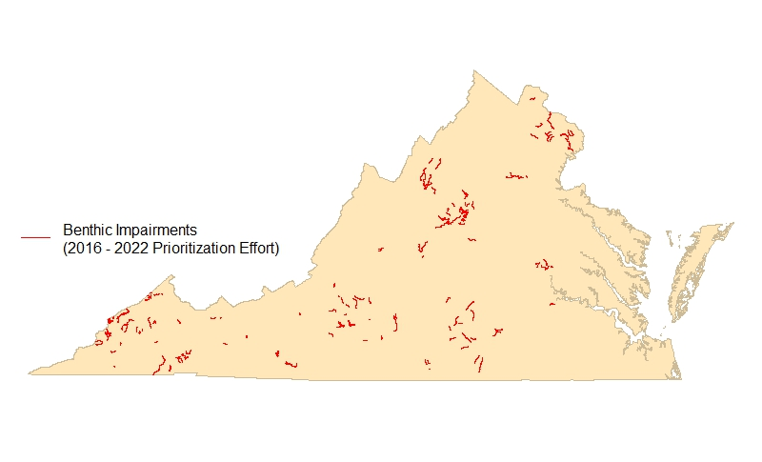
Stressor Analysis in Virginia
Virginia’s Prioritization effort includes 204 benthic macroinvertebrate community impaired segments (assessment units with benthic cause)
Identified as either “TMDL” or “TMDL alternative”
Commitment to EPA for completion: 2016-2022
Stressor analyses need to be developed internally or by a contractor
Notes:
Virginia’s most recent prioritization identified 204 segments listed as impaired for benthic macroinvertebrate community
Each of these require stressor analyses to be completed by us or a contractor
BY 2022
But our TMDL staff are not necessarily biologists who can look at taxa list and start to understand data, so we wrote a report offering guidance on how to complete benthic stressor analyses in VA

Slide 7
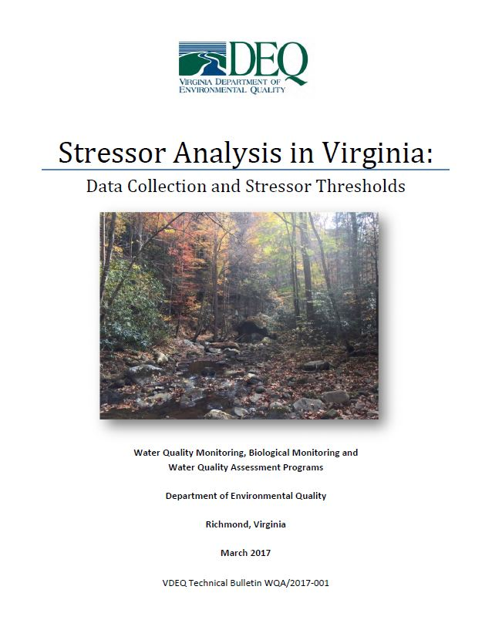
Stressor Analysis in Virginia (continued)
Identifies the cause of the benthic macroinvertebrate community shift
Weight-of-evidence approach
Relies on all available data
Parameters classified as…
Non-stressor
Possible stressor
Most probable stressor
Multiple stressors may be identified
Notes:
Report published in 2017
Uses probmon data- paired benthic and water chemistry dataset- to categorize all available data as either a non stressor, possible, most probable in order to identify potential causes of the shift in biological community
This weight of evidence approach seeks to identify the main stressor or stressors contributing to the response in biology and is really a guide to help walk users through teasing out potential stressors in the multitude of real life cases where there is no apparent smoking gun

Slide 8
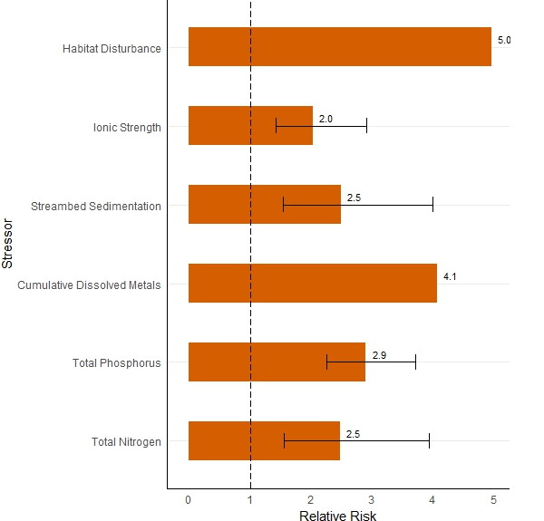
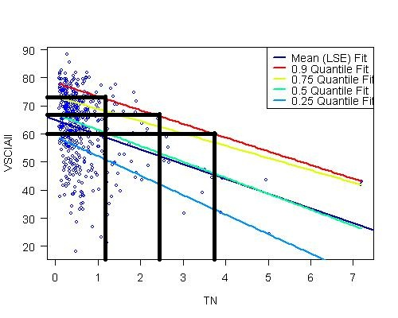
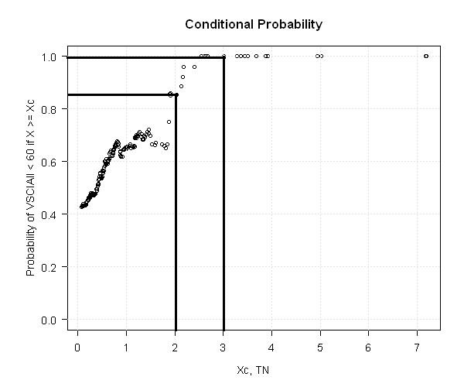
Developing Stressor Thresholds: Statistical Approach
Quantile Regression
Conditional Probability
Relative Risk
Notes:
To develop stressor thresholds published in document, began by comparing our Probmon parameters against benthic community to identify parameters with demonstrated stressor response
After identifying list of parameters where relationships exist, use combination of statistical methods used in our ProbMon program but not readily utilized in TMDL work of quantile regression, conditional probability, and relative risk to find cutoff points at which we could state varying levels of increased risk to biological community

Slide 9
Developing Stressor Thresholds
Probabilistic Data used to define parameter thresholds:
Probability of Stress to Aquatic Life
High
Medium
Low
None
Notes:
Effectively, allow us to put the continuous scale of each parameter into neat little boxes, helping us identify set zones where we can expect incrementally increasing stress to aquatic life.
Stress categories translate to:
“No Stress to Aquatic Life” means that a parameter range reflects an undisturbed, or background, condition in Virginia.
“Low Probability of Stress to Aquatic Life” represents a benthic macroinvertebrate community response that is slightly above background conditions but unlikely to cause a major community shift.
“Medium Probability of Stress to Aquatic Life” and means there is noticeable evidence of harm causing a possible shift in benthic communities with changes noticeably above background conditions
“High Probability of Stress to Aquatic Life” threshold corresponds to values that are among the highest in the Commonwealth and result in degredaton of the benthic community

Slide 10
Stressor Parameters
Dissolved Oxygen
pH
Total Phosphorus
Total Nitrogen
Total Habitat
Ionic Strength
Dissolved Sulfates
Dissolved Chloride
Dissolved Potassium
Dissolved Sodium
Specific Conductance / Total Dissolved Solids
Relative Bed Stability (Quantitative Habitat analysis)
Dissolved Metals (Cumulative Criterion Unit)
Dissolved Oxygen
Probability of Stress to Aquatic Life | Concentration (mg/L)
High | < 7
Medium | > 7, < 8
Low | > 8, < 10
None | > 10
Notes:
We published analyses for 13 parameters
*NOTE* these are not Water Quality Standards. Thresholds are based on biological response apparent in our dataset and can vary considerably from the established WQS
Virginia freshwater DO standard is 4.0 mg/L but we establish 7mg/L as the cutoff where benthic macroinvertebrates most likely to be highly stressed
Why took a lot of work to get through management and have to continually reiterate that these are not WQS

Slide 11
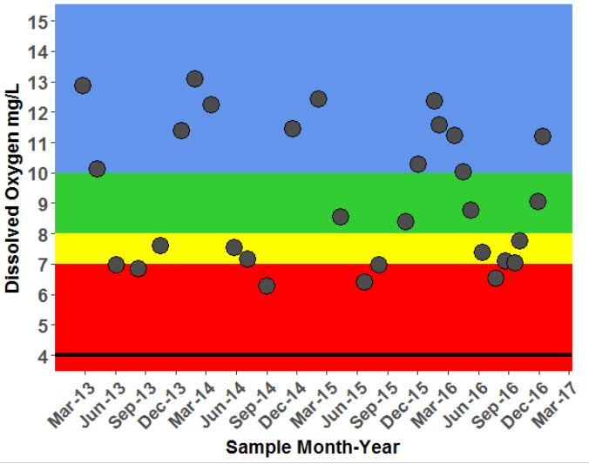
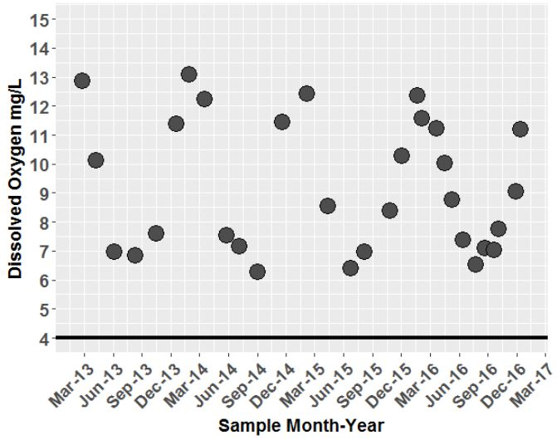
Context is Everything
Notes:
How are these thresholds actually useful?
Imagine TMDL coordinator trying to sift through a pile of data you’ve collected for benthic TMDL and don’t know bugs
Well above WQS and see some seasonal fluctuations in DO with lowest DO during summer months
Doesn’t look alarming until consider probably collected middle of the day, some of highest DO’s this section of stream experiences, okay maybe something going on here
Instead, when we apply the parameter thresholds to each dataset can bring it to life and help see the data from the bug perspective, and impart understanding much faster
Translates to faster sifting through parameters and faster identification of potential issues vs non issues

Slide 12
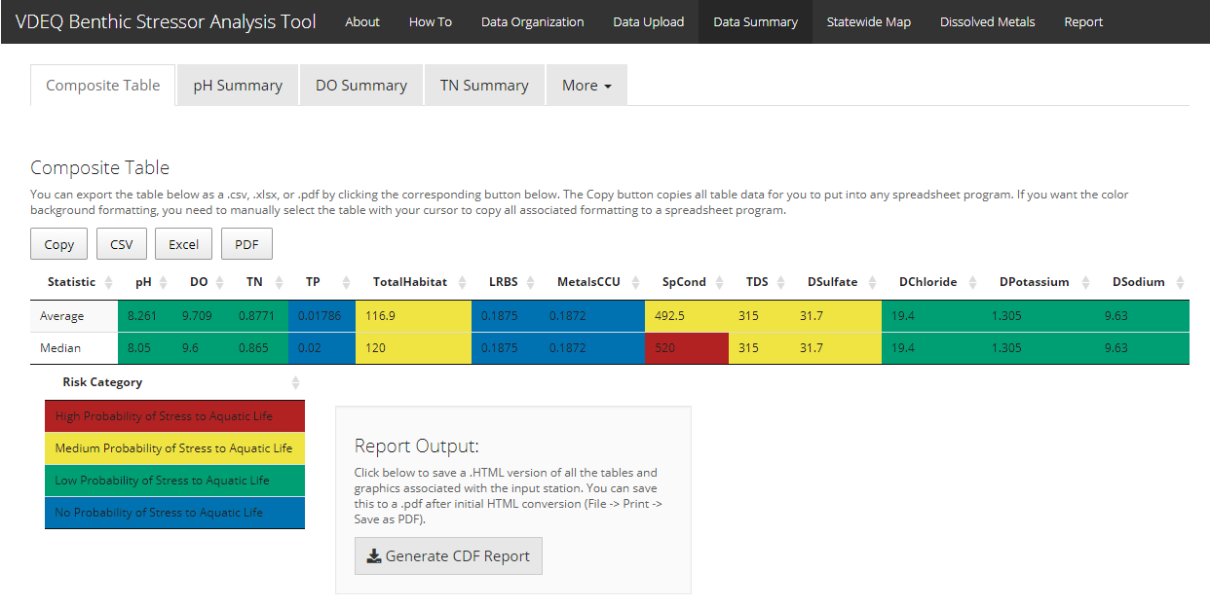
Notes:
To distribute this wealth of information quickly we built Shiny application (R based interactive web application) that allows app users to access the same data analysis and visualization capabilities that have previously only been available people well versed in R programming
App allows users to upload their data to quickly cross reference it with parameter thresholds and drill into where their data fall statewide, and by that specific basin, ecoregion, and stream order
Our second iteration of app also generates about half a draft report pre written for users to further streamline and expedite the analysis and reporting process

Slide 13
Tool Benefits
Anticipated:
Standardize thresholds statewide
Increase biological knowledge of TMDL coordinators
Simplify analytical updates with increasing n
Standardize data collection for follow up monitoring
Standardize data manipulation/analyses
Expedite data manipulation/analyses
Standardize reporting process and products
Expedite reporting process
Cost savings
Unanticipated:
Inadvertently developed nesting rationale and
landowner report tools
Build culture of reproducible reports/research
Introduce automation to regular business practices
Initiate open source culture within VDEQ
Gateway app for the development of additional
analytical applications for cross media business needs
Notes:
Benefits:
Standardize thresholds statewide
Using R so easy to update tool as our prob dataset grows – next slide

Slide 14
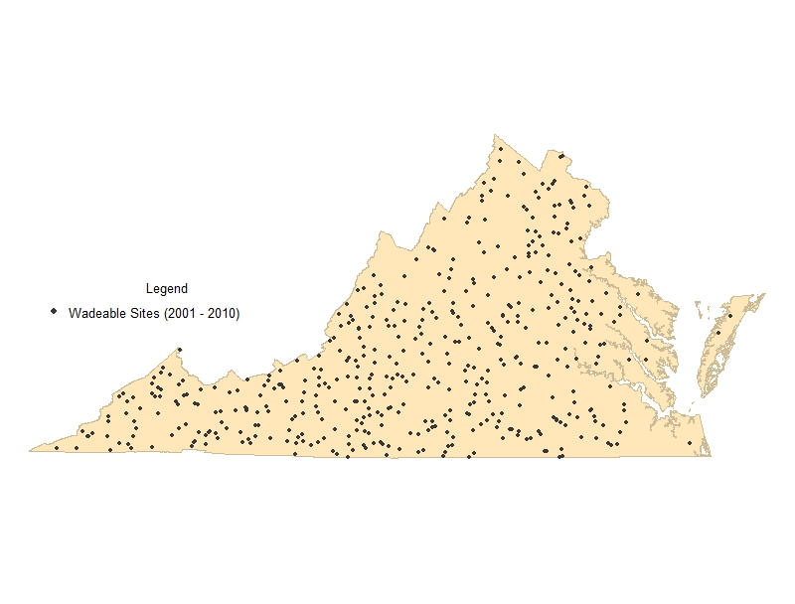
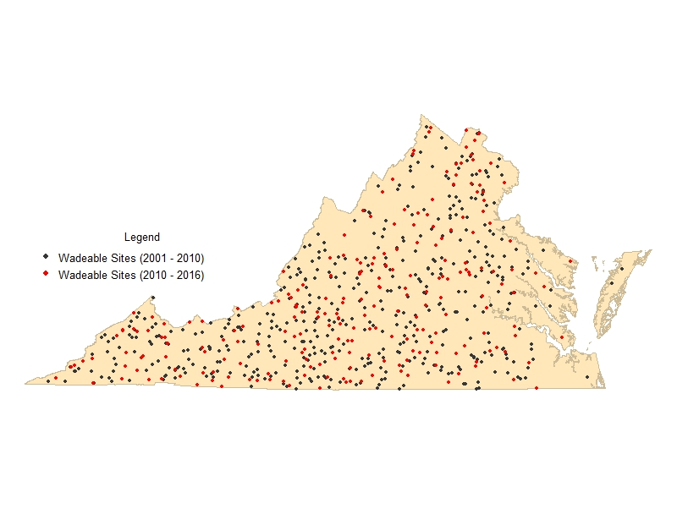
Probabilistic Monitoring Sites: 2001-2016 (n = 735)
Paired benthic and water chemistry/habitat data points Published report (2001 – 2010): n = 474 Interactive Application (2001 – 2016): n = 735
Notes:
Report published on 474 data points
*click*
Currently at 735 and counting
About every two years we push a few hundred more sites into the app to further tighten our confidence intervals on analyses

Slide 15
Tool Benefits
Anticipated:
Standardize thresholds statewide
Increase biological knowledge of TMDL coordinators
Simplify analytical updates with increasing n
Standardize data collection for follow up monitoring
Standardize data manipulation/analyses
Expedite data manipulation/analyses
Standardize reporting process and products
Expedite reporting process
Cost savings
Unanticipated:
Inadvertently developed nesting rationale and
landowner report tools
Build culture of reproducible reports/research
Introduce automation to regular business practices
Initiate open source culture within VDEQ
Gateway app for the development of additional
analytical applications for cross media business needs
Notes:
Standardize reports:
By standardizing reports with Rmarkdown, all graphics, style, and formatting of reports similar
Faster for TMDL coordinators to get the data analyzed and get the report out the door
Allows reviewers to have better understanding of what to expect in reports
Cost Savings:
By giving the data to the people that need it we can complete more internal Benthic stressor analyses- save money on contracting out projects and when contractors are involved it allows TMDL staff to double check and understand data, further expediting larger projects
Unanticipated:
Didn’t expect people to find so many uses for the tool. A hit with biologists and TMDL management for quickly generating nesting rationales
Gateway app- first big app we rolled out from ProbMon group and inspired the tools mentioned previously for the Permit group as well as using Shiny apps for Pollution response, Water quality assessment, etc

Slide 16
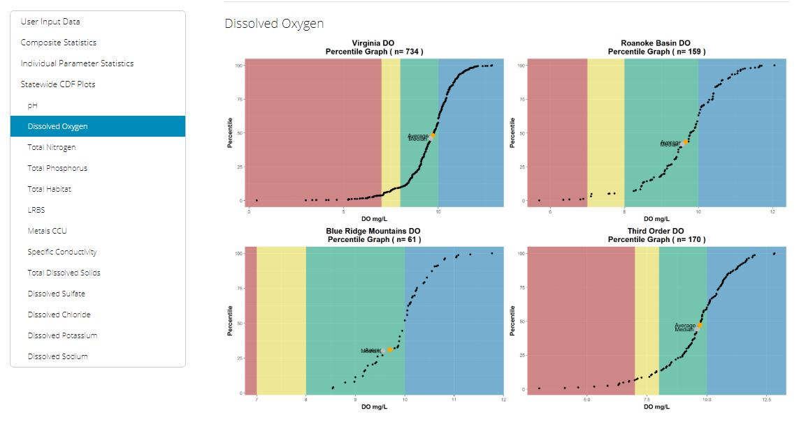
Tool Uses (so far)
Benthic Stressor Reports for:
Catawba Creek (preliminary EPA approval)
Unnamed Tributary to Roanoke River
Mountain Run
Crane Creek
Briery Creek
Smith River
Naked Creek
Lynch Creek
Reed Creek
Allens Branch
Devil Fork
Bark Camp Branch
Monitoring/Landowner Reports
Assessment/Monitoring planning
Dissolved metals assessment
BCG/Tolerance document
Notes:
A number of stressor reports and previously mentioned landowner reports
Use threshold in Assessment application for additional contexts for assessors
Bring it full circle back to some of the other projects mentioned at beginning:
Original Dissolved metals assessment gave birth to the whole background metals application for the permit group
Thresholds were useful throughout BCG projects and statewide tolerance attribution activity

Slide 17
Stressor Tool Demo
Notes:
Deer Branch Example Dataset into app

Slide 18
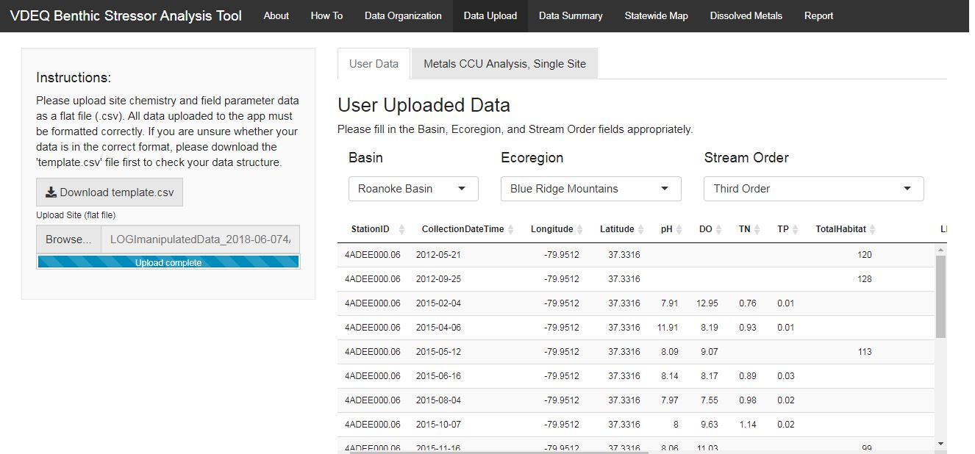
Stressor Tool Demo
Notes:
Deer Branch Example Dataset into app

Slide 19
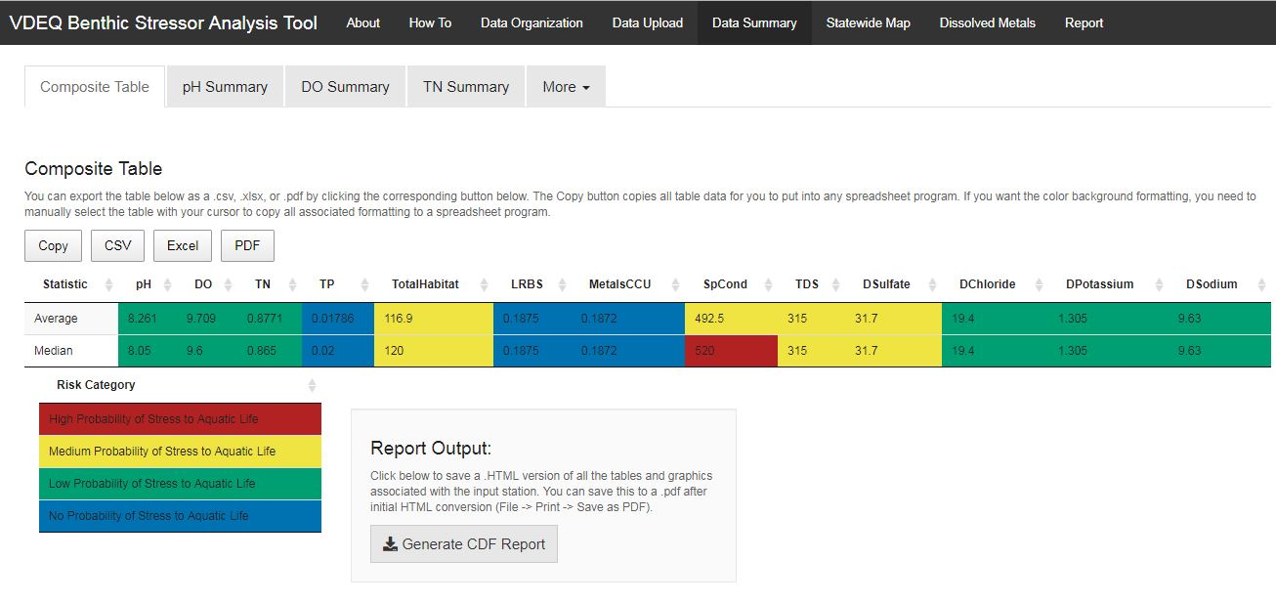
Stressor Tool Demo
Notes:
Deer Branch Example Dataset into app

Slide 20
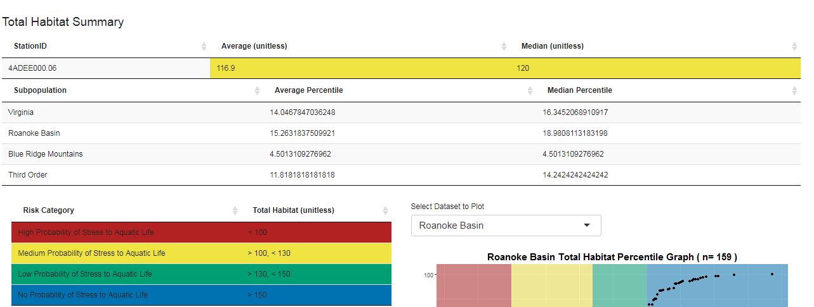
Stressor Tool Demo
Notes:
Deer Branch Example Dataset into app

Slide 21
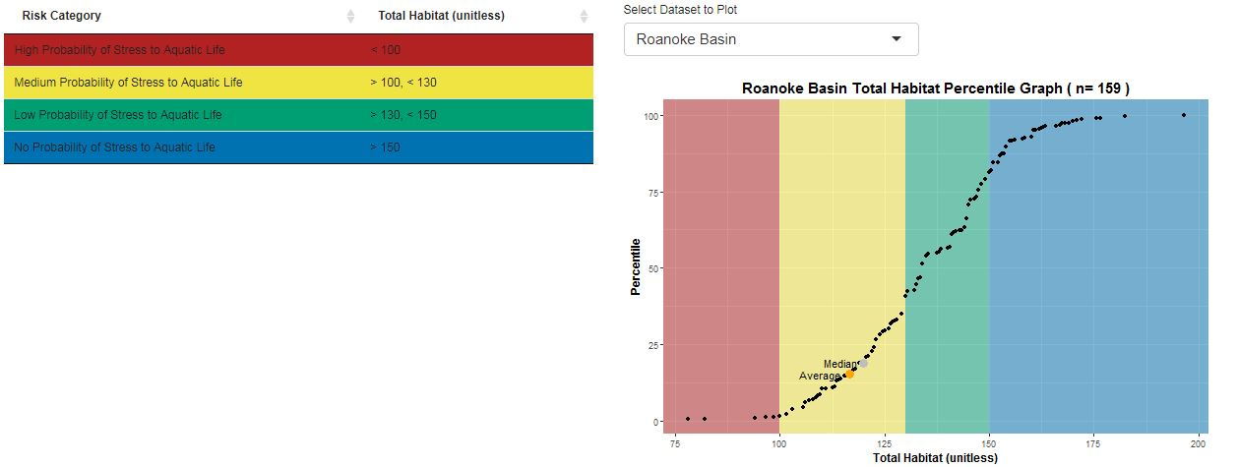
Stressor Tool Demo
Notes:
Deer Branch Example Dataset into app

Slide 22
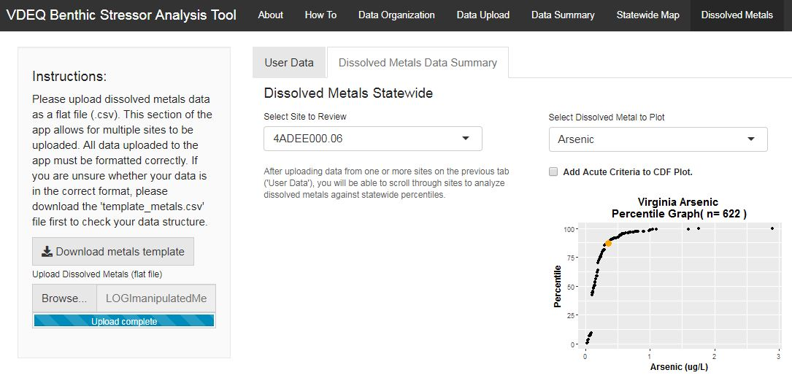
Stressor Tool Demo
Notes:
Deer Branch Example Dataset into app

Slide 23
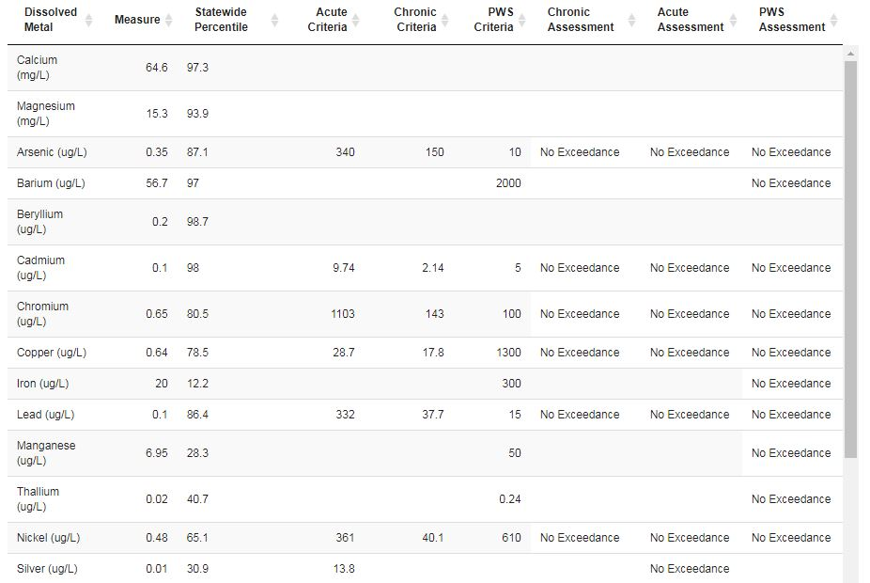
Notes:
Deer Branch Example Dataset into app

Slide 24
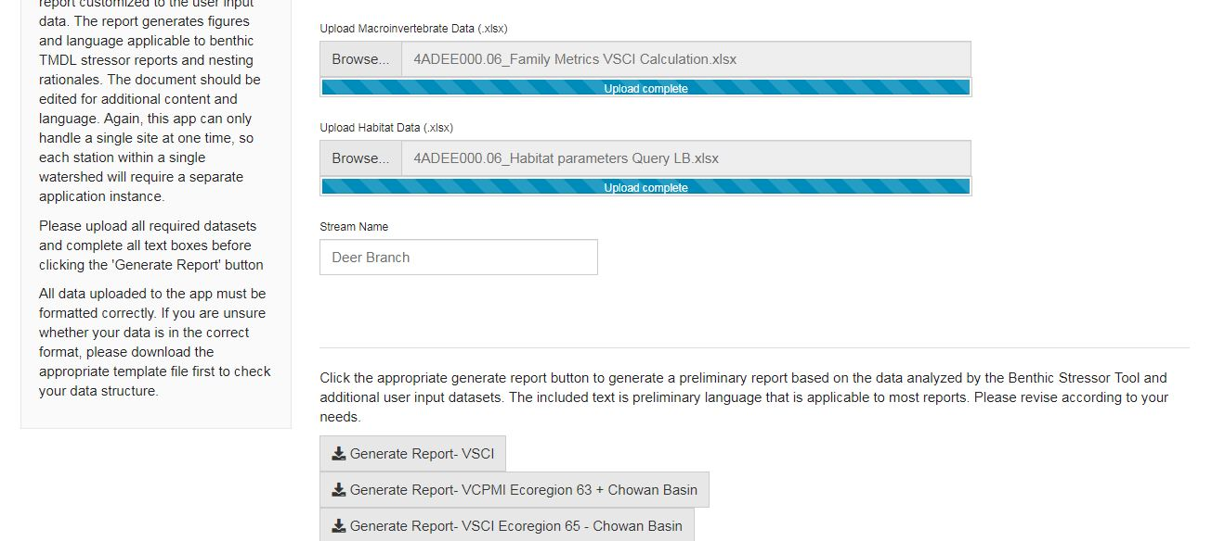
Stressor Tool Demo
Notes:
Deer Branch Example Dataset into app

Slide 25

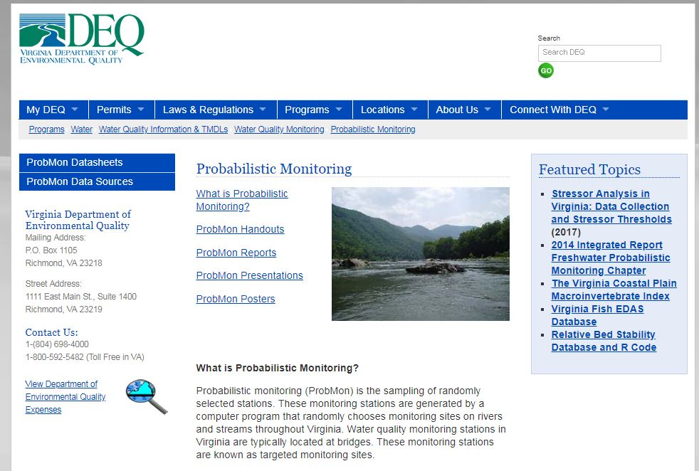
Contact Information
Emma Jones emma.jones@deq.virginia.gov
Jason Hill jason.hill@deq.virginia.gov
www.github.com/VDEQ/VDEQ_BenthicStressorAnalysis
www.deq.virginia.gov/Programs/Water/ WaterQualityInformationTMDLs/ WaterQualityMonitoring/
ProbabilisticMonitoring.aspx

